Slide 1


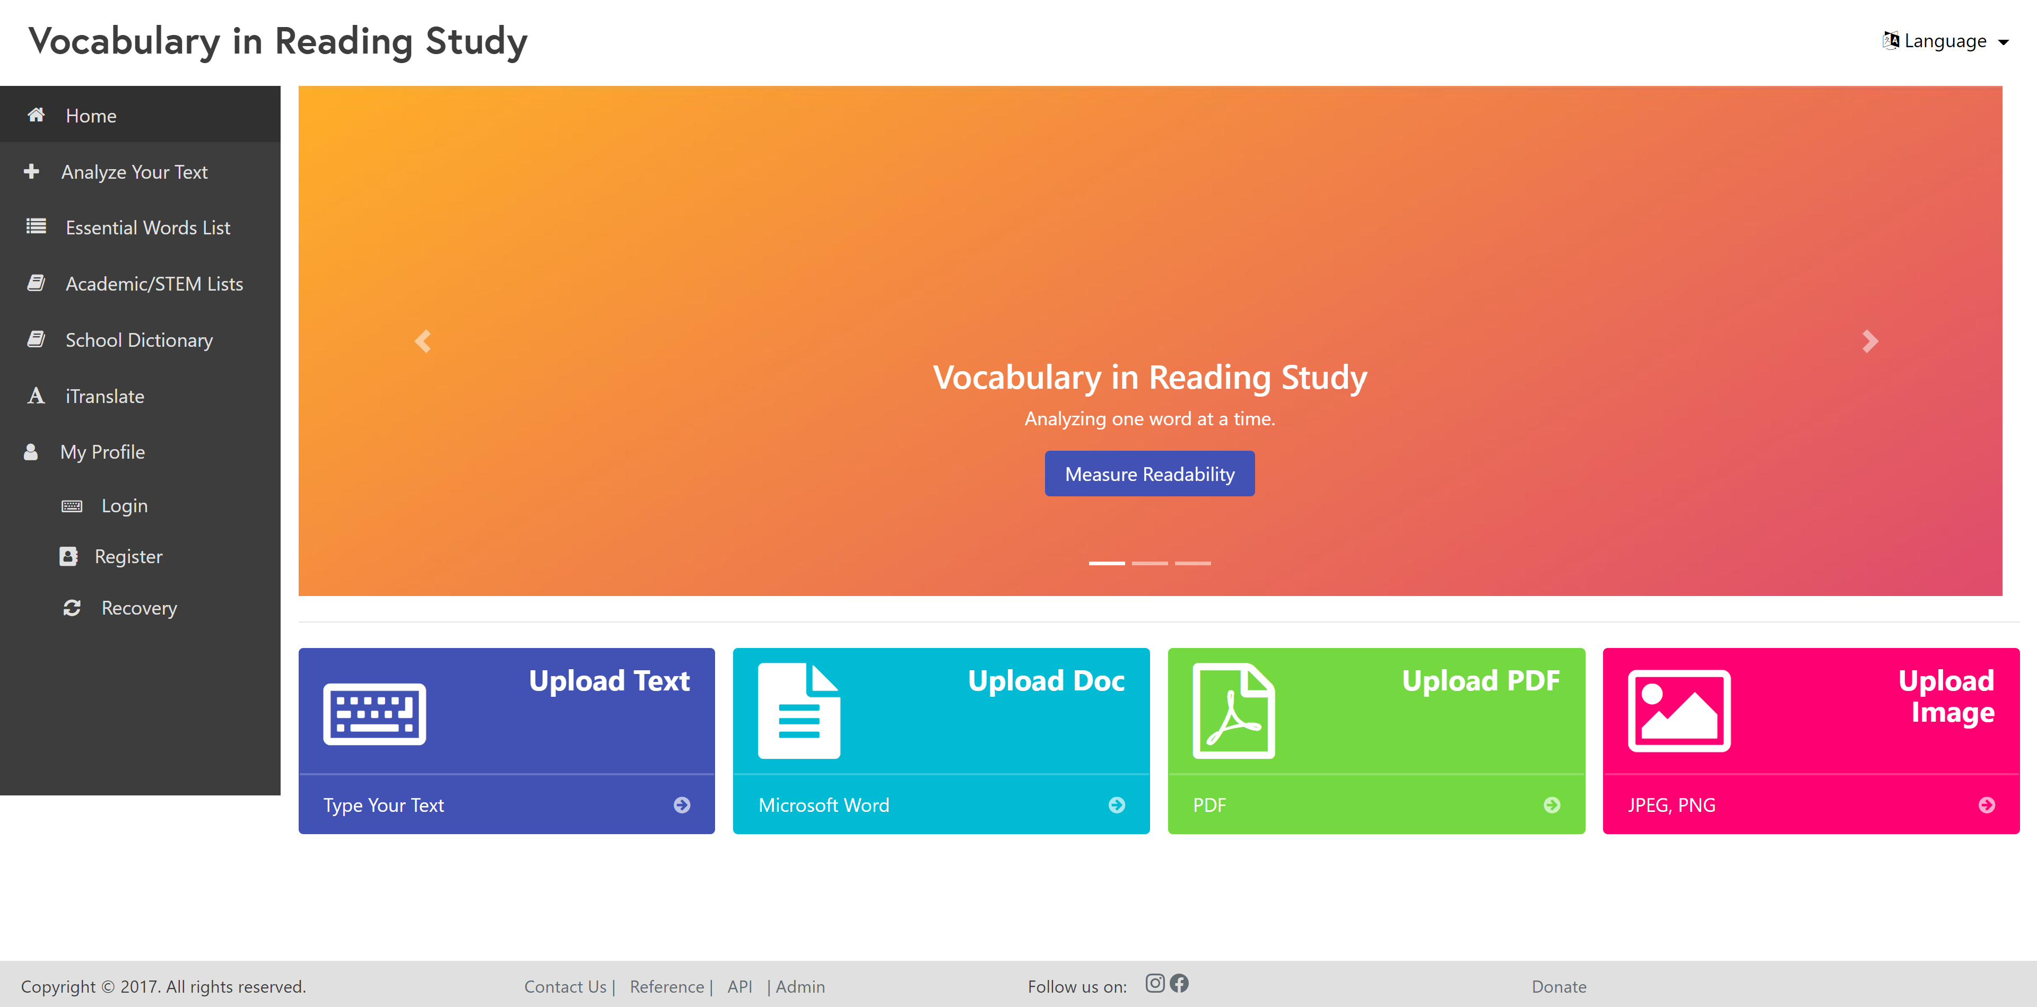
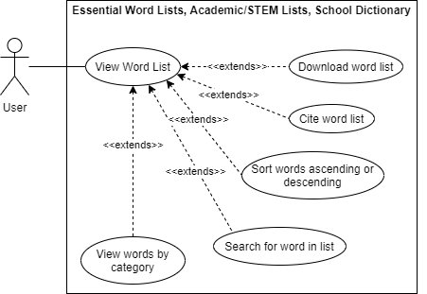
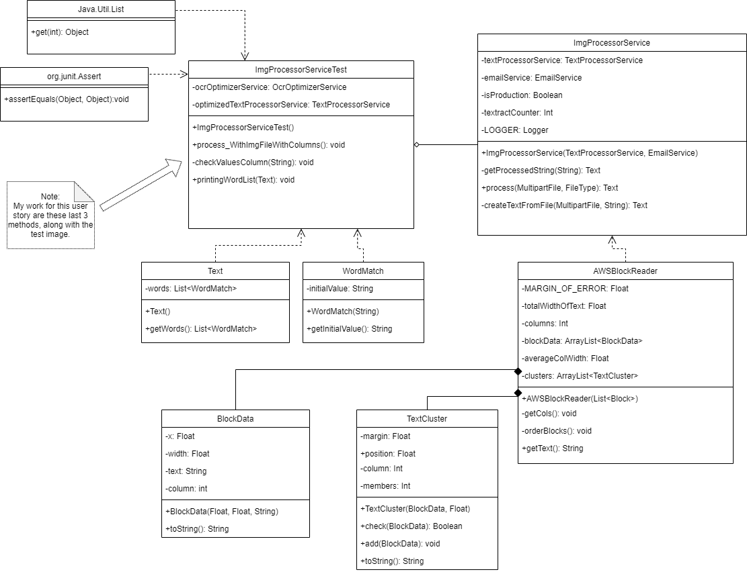
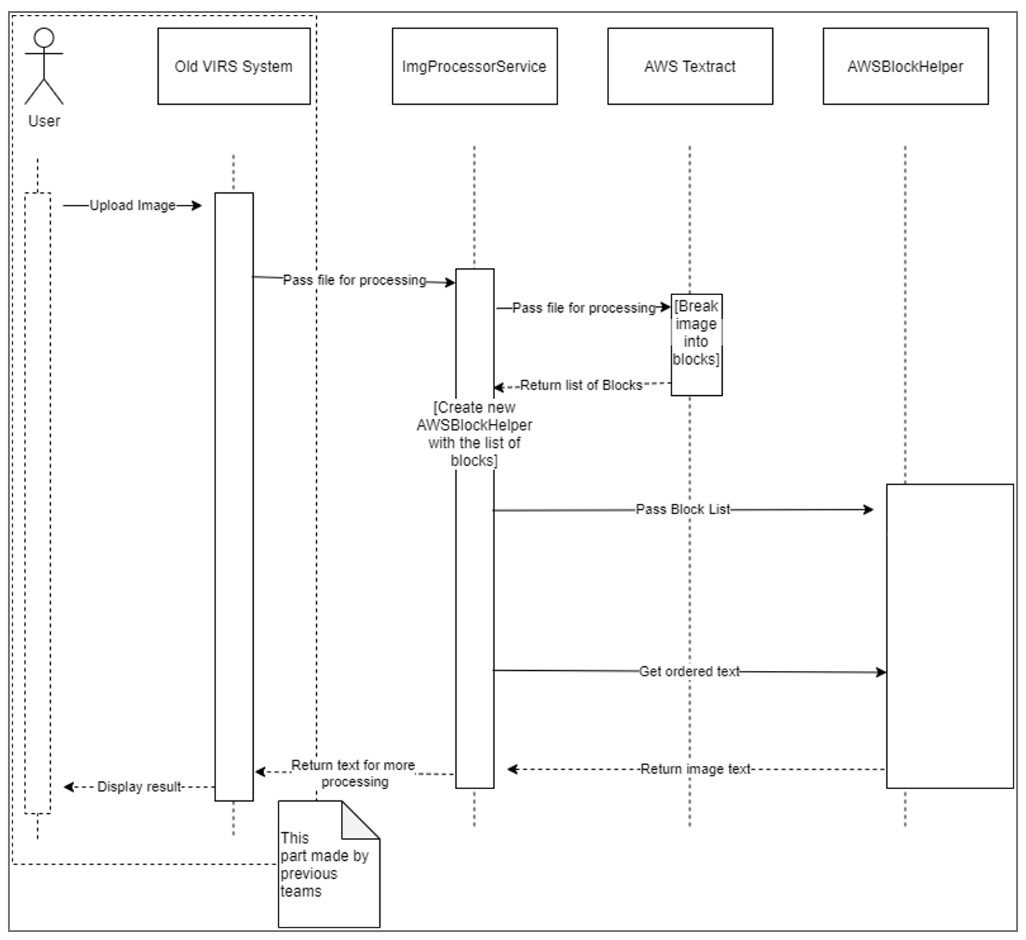




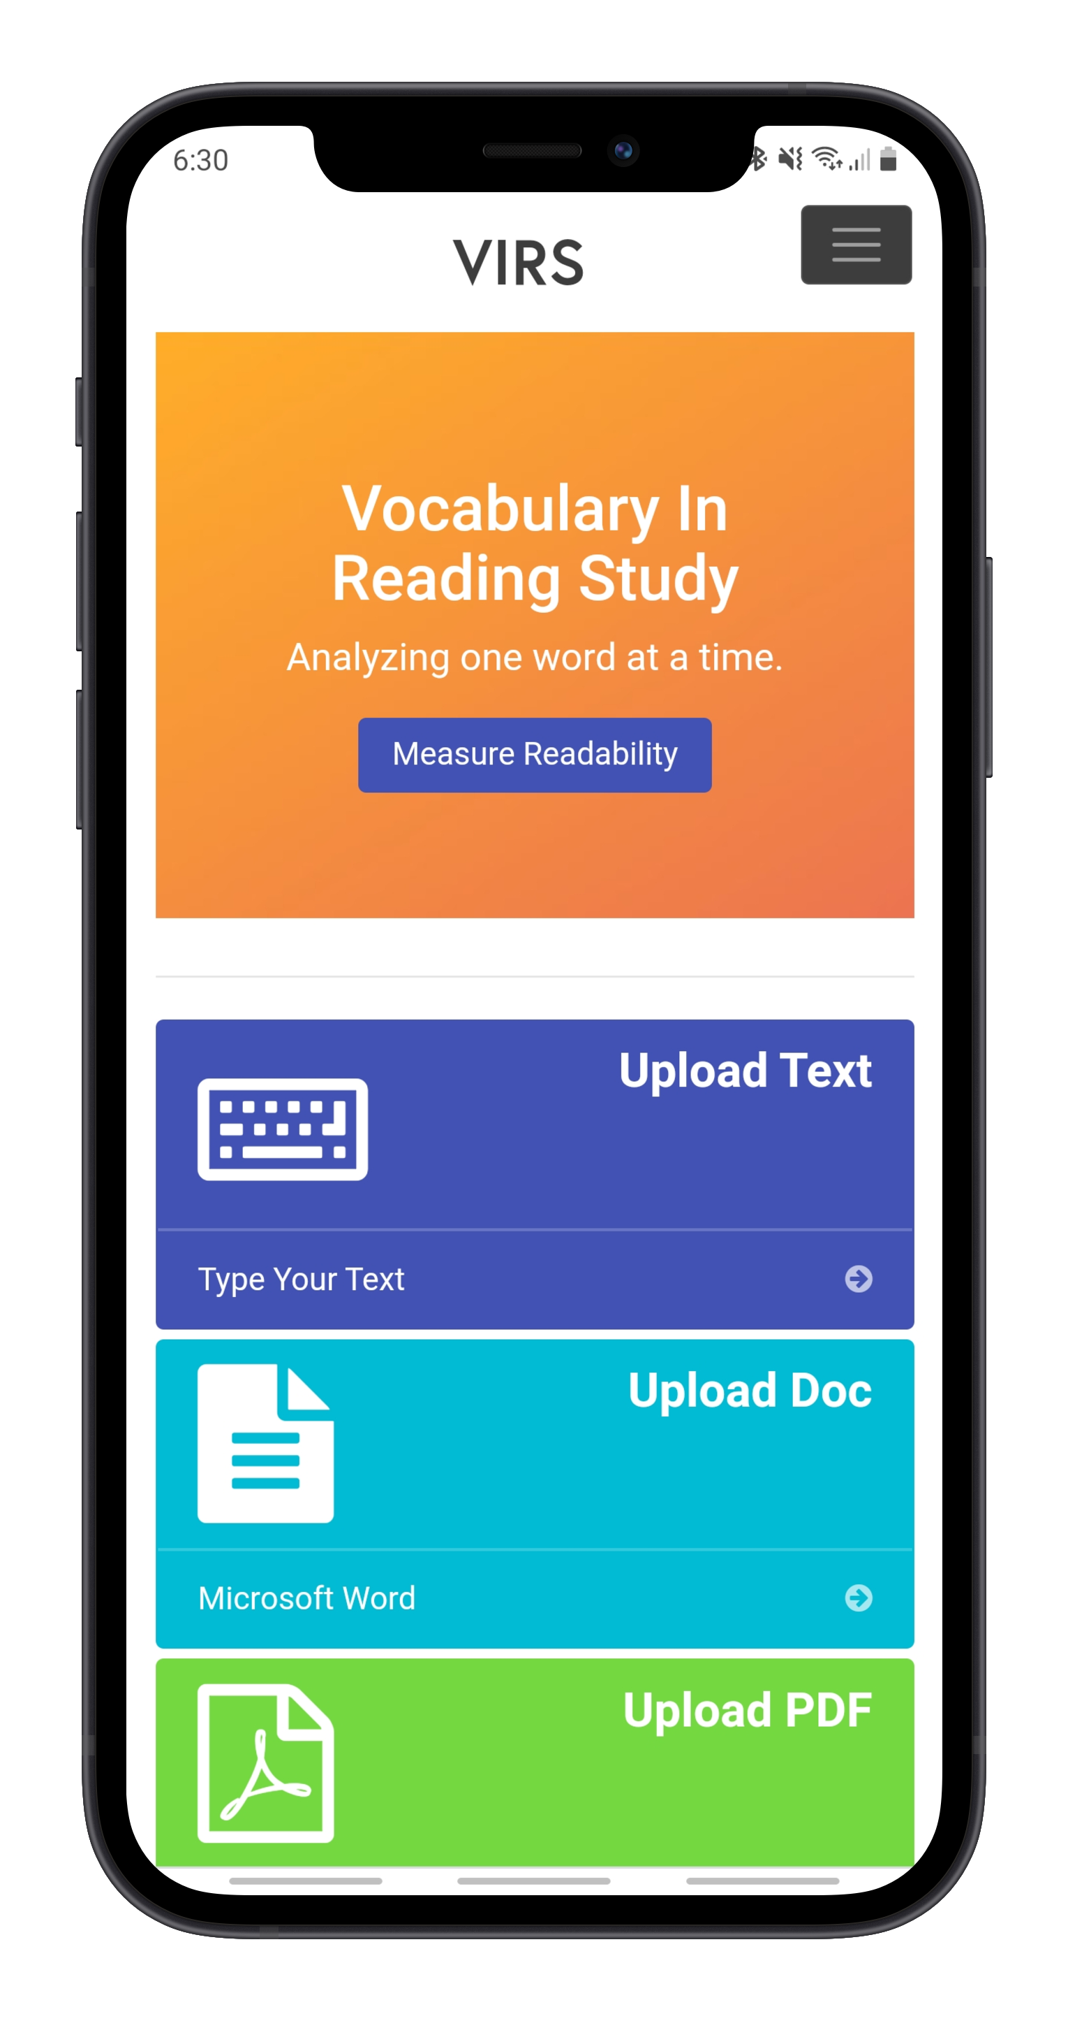
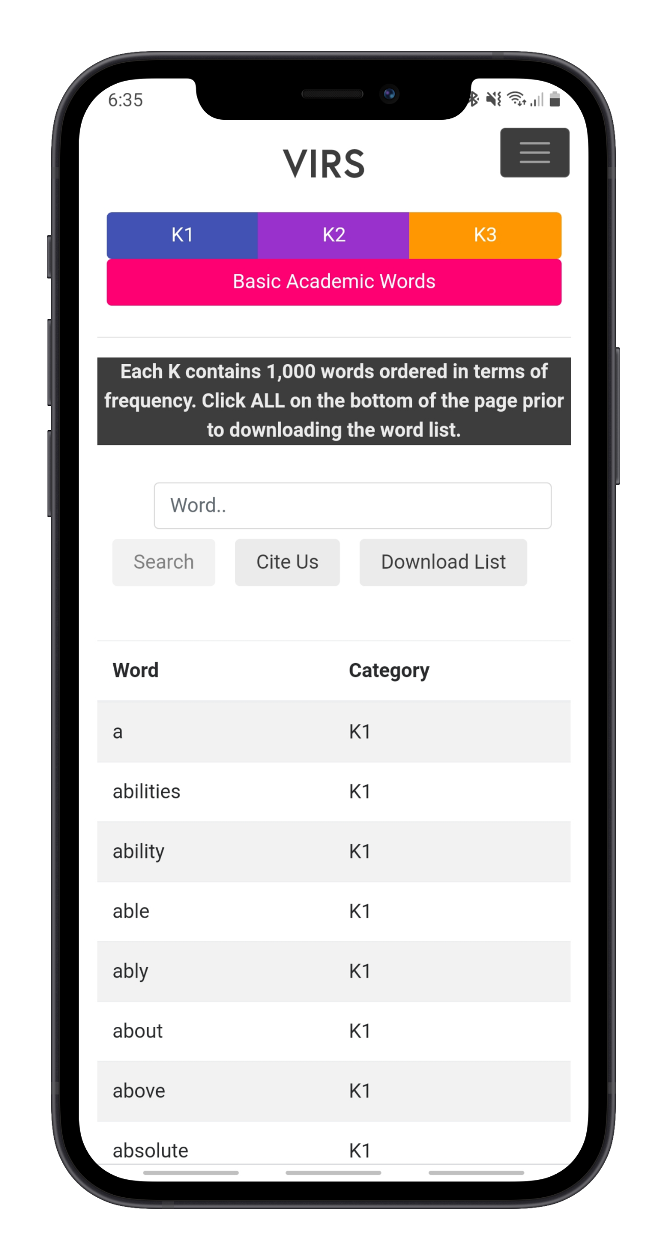
Knight Foundation School of Computing
& Information Sciences
Spring 2021 Senior Design Project
Vocabulary In Reading Study
Students: Regine Donatien
Mentor: Seyedjafar Ehsanzadehsorati
Instructor: Dr. Masoud Sadjadi, Florida International University
Problem
Current System
Requirements
Vocabulary In Readings Study (VIRS) provides an all-encompassing solution for English Language Learners (ELL) who often have trouble learning vocabulary. VIRS can measure the difficulty of text based on input, allow users to see the definitions and frequency of words in a text they are reading, and provides vocabulary tests to assess learning.
Below are some of the issues tackled this semester:
The website’s User Interface (UI) had an outdated appearance
There were some formatting issues when viewing the website on mobile.
Improve text-recognition
The product owner wanted some additional features on the site such as:
A dialog box that explains readability
A button that copies a designated citation
The ability to download the word lists
Hide the Vocabulary Tests tab
This is a screenshot of the website’s homepage. Some of the improvements include a new header, side bar, and reformatted footer.
The UI is more mobile friendly.
The text recognition has been improved.
All of the product owner’s requests have been satisfied.
Figure 1 [1]
The user can download the word list as an Excel sheet. [1]
The user’s uploaded image analysis is more legible and in the correct order.
System Design
Object Design
Implementation
System design has not changed since the previous version.
Angular Model View Controller is used for the front end.
Backend is written in Java.
MySQL is used as the database and the data queries are autogenerated by Spring Data JPA.
The application is deployed on AWS elastic beanstalk.
This is the object design for the text recognition service that was improved this semester.
Verification
Screenshots
Summary
Test Case ID: Download_Word_List
Description: The user can download the respective page’s word list as an Excel file.
Test steps:
Navigate to virs code directory
Run ‘virs.cmd build’ and ‘virs.cmd run’ command
Navigate to localhost:8080
Click ‘Download List’ on Essential Word List, Academic/STEM List, and School Dictionary
Expected result: The word list exported and is saved to the user’s device as an Excel sheet.
Actual result: As expected
Status(Pass/Fail): Pass
Test Case ID: Enhanced_Text_PNG
Description: The enhanced text of a .png file is legible and in order.
Test steps:
Deploy changes to AWS
Go to myvirs.com
Upload a .png file containing text
Press Enhanced Text
Expected result: The enhanced text contains all the text from the uploaded image and is in the correct order.
Actual result: As expected
Status(Pass/Fail): Pass
I helped edit the AWSBlockReader class to adjust the way the block of text was divided and later returned to print on the site. This correction helped to improve the legibility and order of the enhanced text feature on the site.
I created a download list button to export the respective page’s word list onto the user’s device as an Excel sheet among other additional features that addressed the product owner’s concerns.
I updated the UI to where it is more mobile friendly and cleaner overall to keep up to date with current design trends.
The updated UI of the website on mobile. On the left is the homepage and on the right is the essentials word list.
Acknowledgement
I thank Seyedjafar Ehsanzadehsorati for assistance, cooperation and mentorship that I received throughout this process.

